Slide 1
Music Recommendation System
Team Course Instructor
Simran Goindani Prof. Yehoshua Roi
Charvi Madan
Sumukh Vasisht Shankar
Notes:
Simran - Introduction and Motivation
Sumukh - Technical Problem Formulation slides - 3 and 4
Simran - Results
Charvi

Slide 2
Motivation
Develop a recommender system to recommend songs given a playlist.
This will help reduce the human efforts
Help in engaging the audience more with a platform
Input data - songs or a playlist
Output - songs
Notes:
1 min) Describe the problem on a high level. What are you trying to do? When is the input and the output?

Slide 3
Technical Problem Formulation
Data Source: Spotify Million Playlist Challenge
(https://research.atspotify.com/2020/09/the-million-playlist-dataset-remastered/ )
Data consists of data and metadata related to 1M playlists. This includes song names, artist for each song, song duration, track ID, number of songs in the playlist, artist ID, etc., in a json format.
Data Processing:
Spotipy API for fetching audio features
~65M songs with audio features
Playlists in JSON format
Playlists in CSV format
1M Playlists
Audio Features include key, tempo, danceability score, acousticness, loudness, speechiness, etc.

Slide 4
Challenges faced with the dataset
Working with the whole dataset was computationally too intensive!
Restrictions on the number of Spotipy API calls that can be made in a minute. This hindered our data collection process a lot even though we could implement parallel processing.
Clustering and DImensionality Reduction Algorithms took forever to run even on 10% of the data (6.5M songs - 100k Playlists)
Solution?
We choose to go ahead with a small sample size of ~15k playlists (150k songs).
Found a much more articulated dataset on Kaggle with the same audio features we wanted.

Slide 5

Clustering Algorithms
KMeans
DBSCAN
Spectral Clustering
Gaussian Mixture Model
Agglomerative Clustering
Input Features
Valence , Year, Accousticness, Danceability
Duration in ms, Energy, Explicit,
Instumentalness, Key, Liveliness, Loudness,
Mode, Popularity, Speechiness, Tempo
Notes:
Describe the algorithm you chose to apply to solve your problem. If you tried more than one, you can tell us more, or you may want to just focus on the most interesting one
Include input features
'valence', 'year', 'acousticness', 'danceability', 'duration_ms', 'energy', 'explicit',
'instrumentalness', 'key', 'liveness', 'loudness', 'mode', 'popularity', 'speechiness', 'tempo'

Slide 6
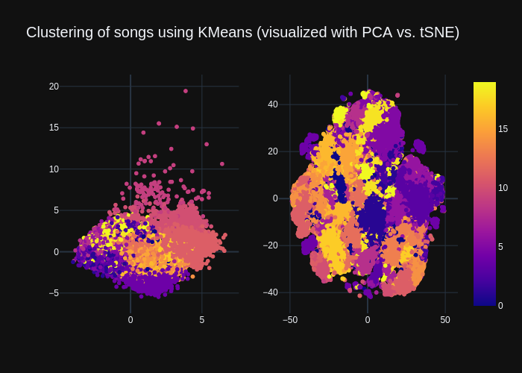
Results

Slide 7
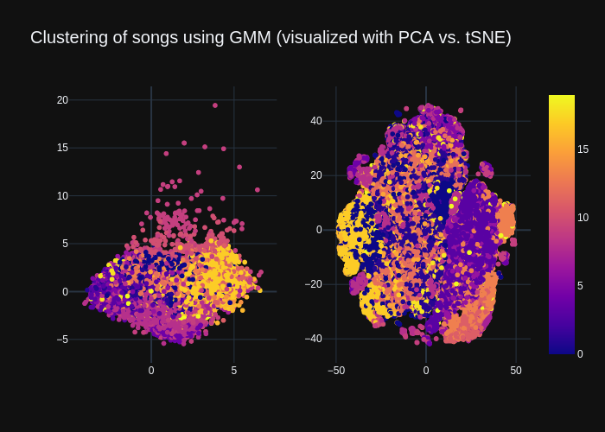
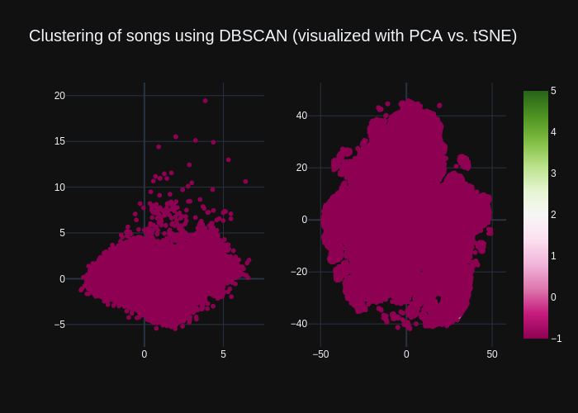
Results

Slide 8
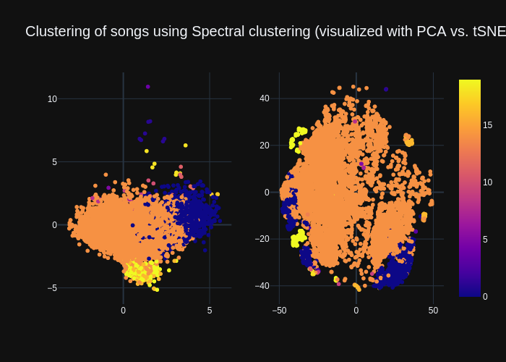
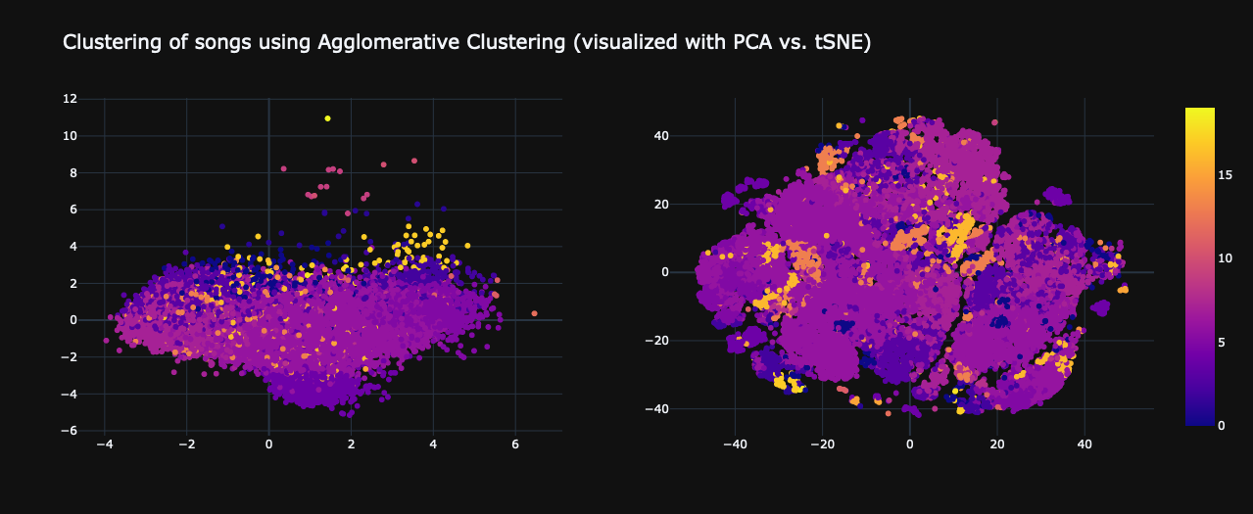
Results

Slide 9
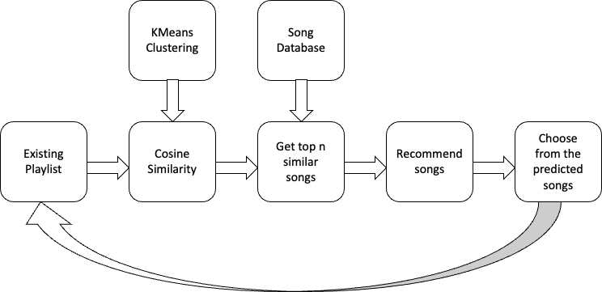
Recommender System
Notes:
So this is the workflow of our recommender system , We decided to go ahead with content based filtering since we did not have access to any sort of user related data.
The recommender system takes in a playlist as an input (1 song - n songs), and suggests tracks that can be added to the existing playlist.
The songs are recommended based on the cosine similarity of the audio features of the tracks that are already in the playlist.

Slide 10
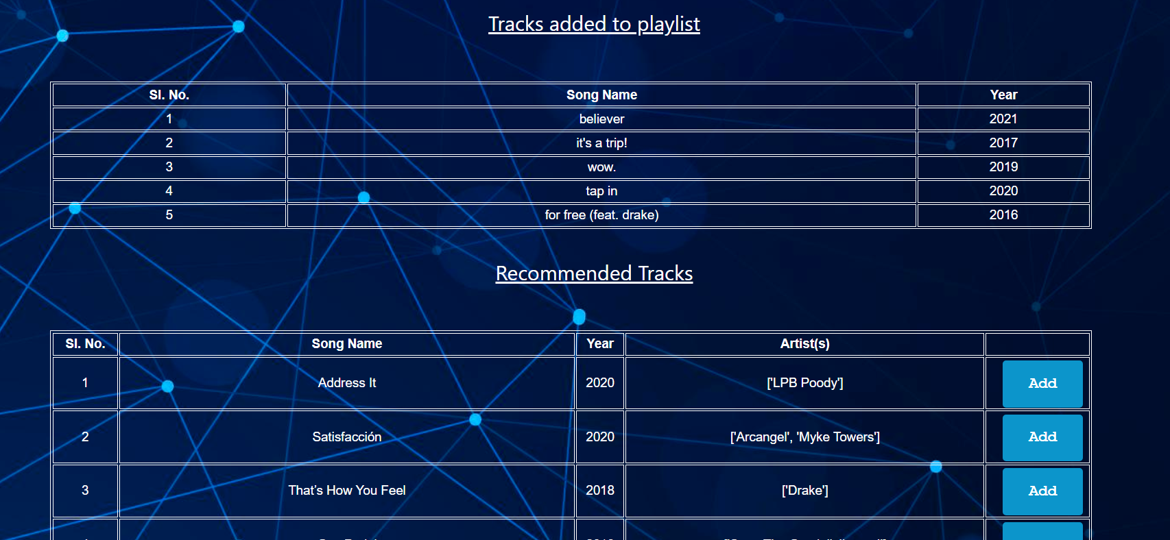
RS Results
Notes:
These are the results from the recommender system, we can see for a playlist with 5 songs, the system recommends more songs to be added to it
Here’s the full stack application built for our recommender system,

Slide 11

Future Work
Collaborative filtering requires no domain knowledge for extracting features for the model. Also users can explore new interests. This approach can be used by adding certain extensions-:
Including user profile data into the system
Make the algorithms scalable by using clustering approach before hand
Content based recommendation system using clustering techniques produced cohesive and well separated clusters and as a result, returned good recommendations to user instance. This can be further enhanced by -:
Incorporating the use of collaborative filtering in the current model such that clusters are formed based on similarities between users in terms of their ratings and reviews provided.
Notes:
For future work , we plan on implementing collaborative filtering by including user profile data into the system and making the algorithms scalable by using clustering before hand. Moreover, the existing content based filtering can be enhanced by incorporating collaborative filtering with it .

